Slide 1
Text recognition and Text to speech

Slide 2
Text Recognition
Text recognition deals with the notion of identifying the underlying text patterns in an image or any other visual media.
Various text recognition processes can be used to recognise text.
One of the most popular one being OCR
OCR stands for Optical Character Recognition
The main idea of using OCR is to recognize text characters.
In python we can use OCR technique by the help of a pre-trained ocr tool named PyTesseract

Slide 3
Text Recognition
Then recognize the textual date in the image using PyTesseract.
OCR uses artificial intelligence for text search and its recognition on images.
Tesseract is finding templates in pixels, letters, words and sentences. It uses two-step approach that calls adaptive recognition. It requires one data stage for character recognition, then the second stage to fulfil any letters, it wasn’t insured in, by letters that can match the word or sentence context.
Import command is “import pytesseract”

Slide 4
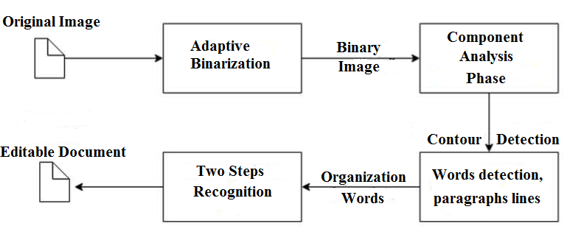
Tesseract Architecture

Slide 5
Text To Speech
There are several pre-trained TTS modules out of which gTTS is one of the most popular one.
GTTS is Google's open source python library and a CLI (Command Line Interface) tool which helps in converting Text to speech signal.
GTTS stands for Google Text To Speech and the command used to import its functionality is “ from gtts import gTTS ”

Slide 6
Coding procedure:
Step 1: Import pytesseract, os, gtts and also Image from PIL.
Step 2: Specify the tesseract directory and load the image.
Step 3: Use image_to_string() to convert image to string.
Step 4: Specify the language as ‘en’
Step 5: Use gTTS and convert text to speech in the following format
output=gTTS(text= , lang= ,slow=False)

Slide 7
CONCLUSION
The major objectives of this project, recognizing different types of text in both damaged state and unknown font(Handwritten) and then expressing the output via both documented text and speech signal are met and dealt successfully.
But there are certain disadvantages to be addressed and improved. Hence we are going to deal with those in the coming future.

